Slide 1

AIoT Bedroom Environment
Sha Tin Methodist College - Au Ka Long

Slide 2




Real life problem
Can’t get a comfortable sleep and comfortable relaxing place.
Example
Get on bed and ready to sleep but lights is still on ,this would be hard and tiring for you to get up again.
Weather change fast and you are cold or hot, needing air-conditioner or heater to be on.

Slide 3


My idea
Let a machine with sensor detecting your need and automatically help you to give a comfortable environment.
Examples
Auto turn on lights when you are ready to sleep
Auto turn on air-conditioner/hearer and auto change the temperature for your best comfort.

Slide 4





How does it work
Three main parts
Input(sensors)
AI
IOT

Slide 5




How does it work --- Input
IR camera
The temperature of the environment
Visual camera
Get the image(high privacy)
-> Support the object detection
-> Constraints for automation

Slide 6
The Advantages of IR camera
High privacy
Cannot capture the face
More useful constraints
Temperature
More accurate body gesture
Can detect the body gesture even the person is covering a blanket

Slide 7
Limitation of IR camera
Lack of datasets
Do not have a good dataset
Inconsistent image formats
Even there are some dataset outside,
That may not be compatible
Result
Use the visual image for now
We can change it for future

Slide 8
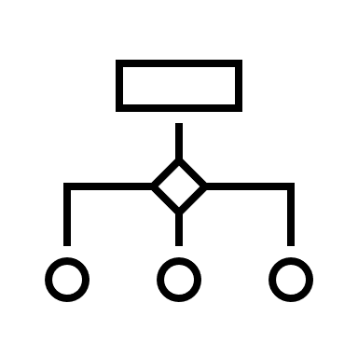



How does it work --- AI
Object detection
Detect the position of person
Detect the gesture of person
Detect the position of bed
Detect the position of phones

Slide 9

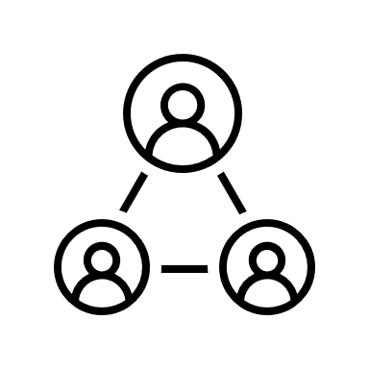


How does it work --- IoT
Two kind of triggering different devices
Events triggering
Different kind of body gesture
Temperature change
Habit trigger
Turn on air-conditioner before sleep time

Slide 10
How does it work --- Extensibility
Two ways to extend
Add new IoT devices
Auto detect new devices(network / camera->Events)
Include to the environment
Add other non-IoT objects
Auto detect new object(camera->Events)
Remind you to use it, etc.

Slide 11
Automations
With all of these constraints, we can have dozens of automation.

Slide 12
Automations – Best Temperature
We can collect the bed and human temperature
i.e
controlling the air-con to keep bed temperature on 27-31°C
Detect the skin temperature of human to prevent too cold or hot

Slide 13
Automations – Auto lights
Detection of human’s gestrure
If human is lying on bed and not touching a phone
We turn off the lights
If human is awake
We turn on the lights

Slide 14
Automation – Danger detections
See if a human sleeping of the bed actidentally
Call for ambulance if needed
Loosing temperature rapidily
Call for ambulance

Slide 15
Automations – Your habits
Just include your habits with all thses constraints
Like start playing music when lying on bed
Turn off the air con on mid night
Turn on the air con before sleep

Slide 16
How does it earn?
Selling the IR camera
Selling other smart home product to integrate with environment
High extensibility make this possible

Slide 17
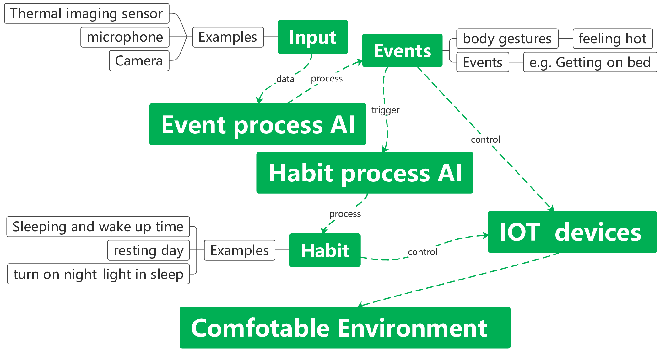
How does it work --- Workflow

Slide 18
THE END

